Slide 1
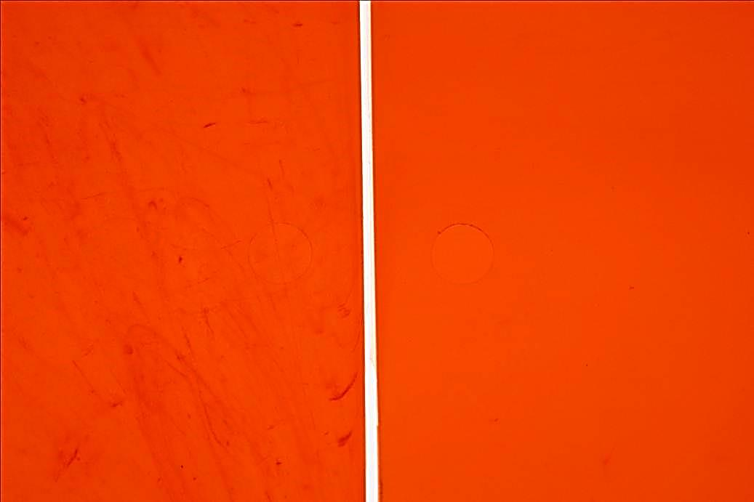

Searching for
a solution ?

Slide 2


Promix
Solutions !

Slide 3
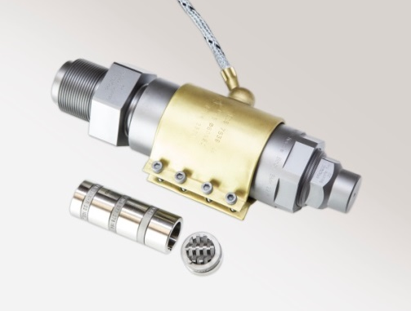
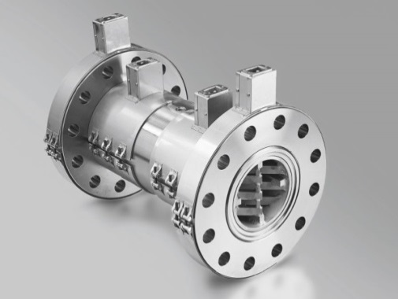
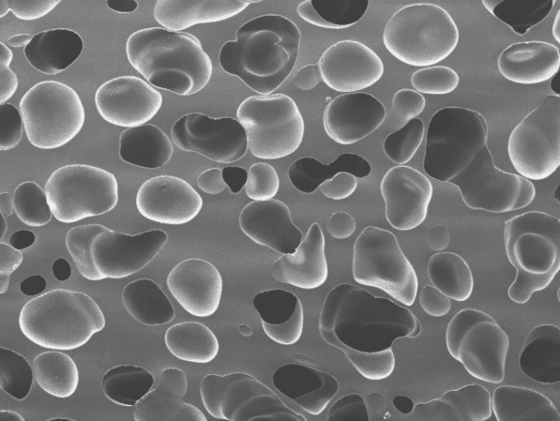
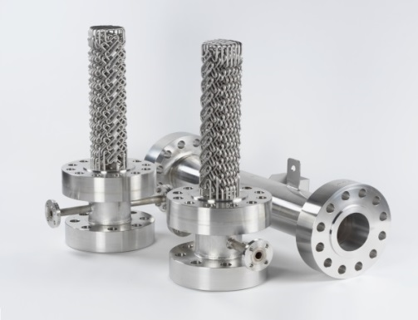
Your partner in the plastics processing industry
MIXING NOZZLES
MELT
BLENDER
FOAM
EXTRUSION
MELT
COOLER
Founded in 2012 as a spin-off of Sulzer Chemtech
Subsidiaries in Winterthur, Switzerland and Linden, Germany

Slide 4
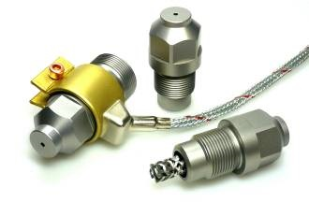
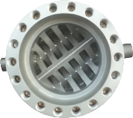
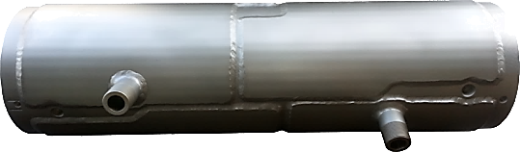
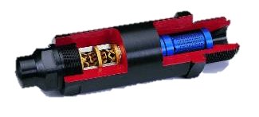
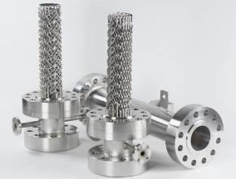
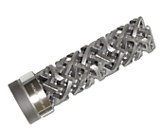
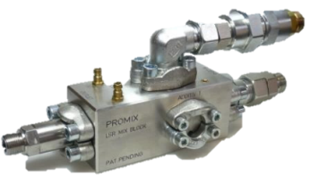
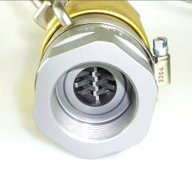
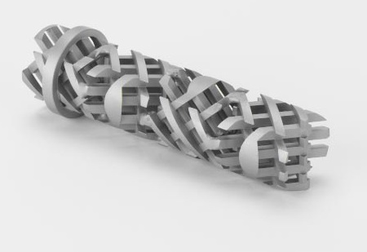
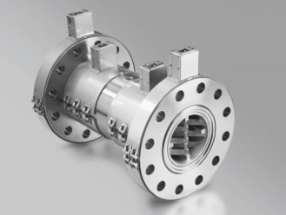
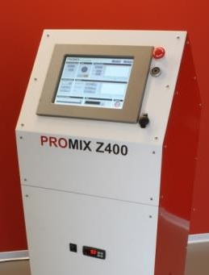
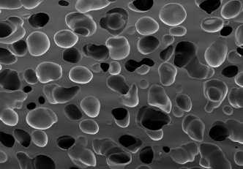
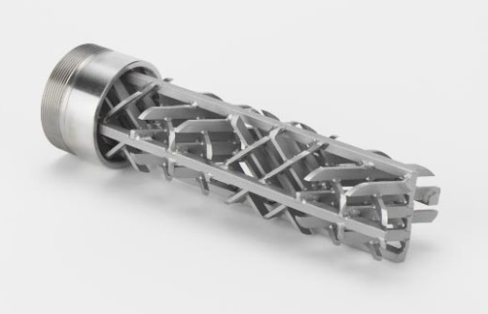

Leading in static mixing technology
2013 Unique P1 cooling mixer
1995 First Mix Nozzle
2007 Mix Tip
2011 PMC Melt cooler
2009 Mix Body
2012 SMB plus new benchmark for Melt blenders
2004 LSR Mixing Block
1997 Melt blender SMB-H
1975 First Mixer Application Plastics Processing
2014/2015 CO2 / N2 Gas dosing unit
2007 Promix
Foam Extrusion
1996 Melt blender SMB-R

Slide 5
Application range
Applications
  Injection Molding
  Hot Runner
  LSR
  Extrusion
  XPS
  Physical high density foam extrusion
Polymers
  Thermoplastics LDPE, HDPE, LLDPE, PP, PS, HIPS, etc.
  Technical Polymers POM, PMMA, TPU, PET, PBT, SAN, ABS, PC, LCP, PA, PC/ABS
  Filled Polymers Glass-fibers, mineral fillers, etc.
  Foamed polymers PS, PE, PP, PET, PVC

Slide 6
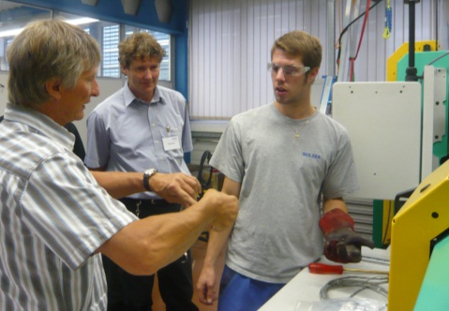
Your partner in the plastics processing industry
More than 30 years experience in plastic processing
The biggest standard mixer portfolio in the industry
Complete customized solutions including housings and nozzles
Fast delivery of standard mixers and mixing nozzles within 5 days
Local support in most important countries through own sales agents or local reps
More than 30’000 references worldwide

Slide 7
Injection molding technology

Slide 8
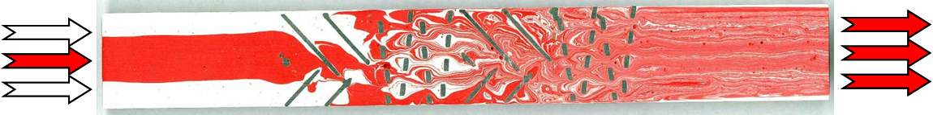
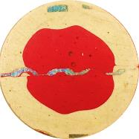
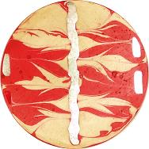
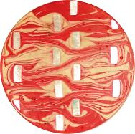
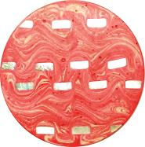
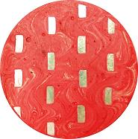
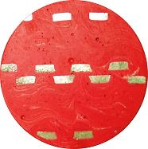
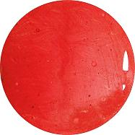
How it works
Inlet
-laminar flow-
Mixing
element 1
Mixing
element 2
Mixing
element 3
Mixing
element 4
Outlet
-laminar flow-
additionally
After After After After 1 Element 2 Elements 3 Elements 4 Elements
After
6 Elements
Inlet
After
5 Elements
  Homogenization of additives as master batch, color, flame retardant, different polymer grades etc.
  Reduction of radial and axial temperature variations
  Equalization of velocity differences across the flow channel

Slide 9
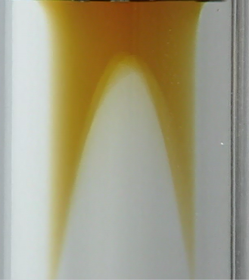
Effective temperature homogenization
In an empty pipe polymer melts will form a laminar profile
Promix melt blenders destroy the laminar profile and create a very effective cross mixing resulting in:
Equal velocity
Equal temperature
Narrow residence time distribution
Excellent melt homogeneity
Notes:
Temperature profile of a PE melt after emersion of a flat film die

Slide 10
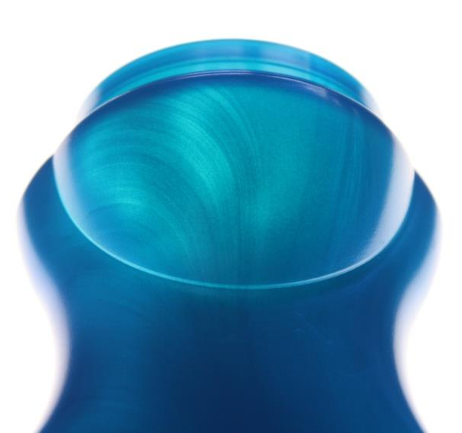
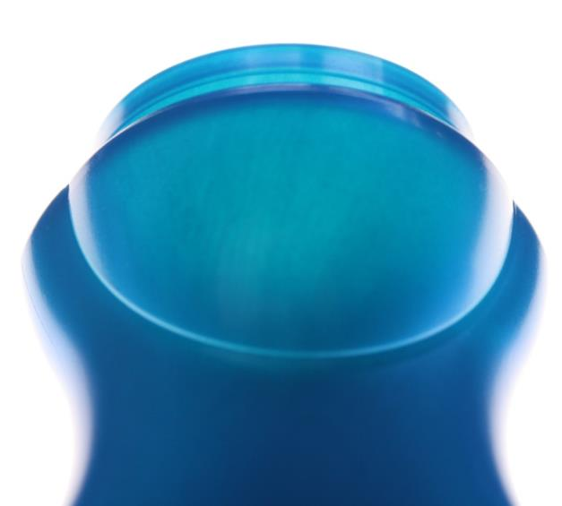
Effective color homogenization
Saving of 20 – 30% master batch = 1000 – >10’000 CHF per year
Equalized color depth / better color appearance

Slide 11
Cycle time reduction
melting (dosing & back pressure)
injection
holding
pressure
cooling
  Shorter cooling time due to reduced possible melt temperature (- 10 to 20 ºC) resulting from flat temperature profile during screw stroke, especially attractive for applications where cooling time is limiting the cycle time → cooling time > melting time i.e. for thick wall parts
  Shorter melting time required due to reduced screw backpressure (approx. 5 bar instead of 15 -30 bar), especially attractive for applications where melting time is limiting the cycle time → melting time > cooling time i.e. for thin-walled parts with long flow paths
  Reduced injection speed can reduce shrinking and therefore lead to faster cooling (amorphous Polymers)

Slide 12
Benefits of Promix Mixing Nozzles
  Effective avoidance of color streaks
  Equalized color depth / better color appearance
  Saving of 20 – 30% master batch (= 1’000 to >10’000 CHF savings / year)
  No brilliant spots due to homogenization of temperature profile
  Reduced cycle time due to optimized processing parameters
  Better tolerances
  Improved processing of recyclates (usability of more recyclate or better product quality)
  Improved balancing of hot runner systems
Notes:
Show sequence 5) High low viscous mixing from MRT DVD

Slide 13
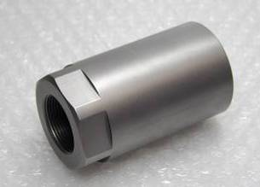
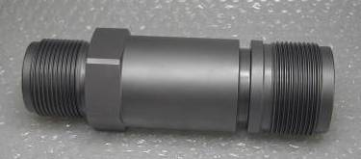
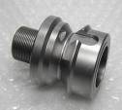
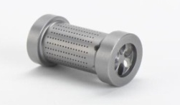
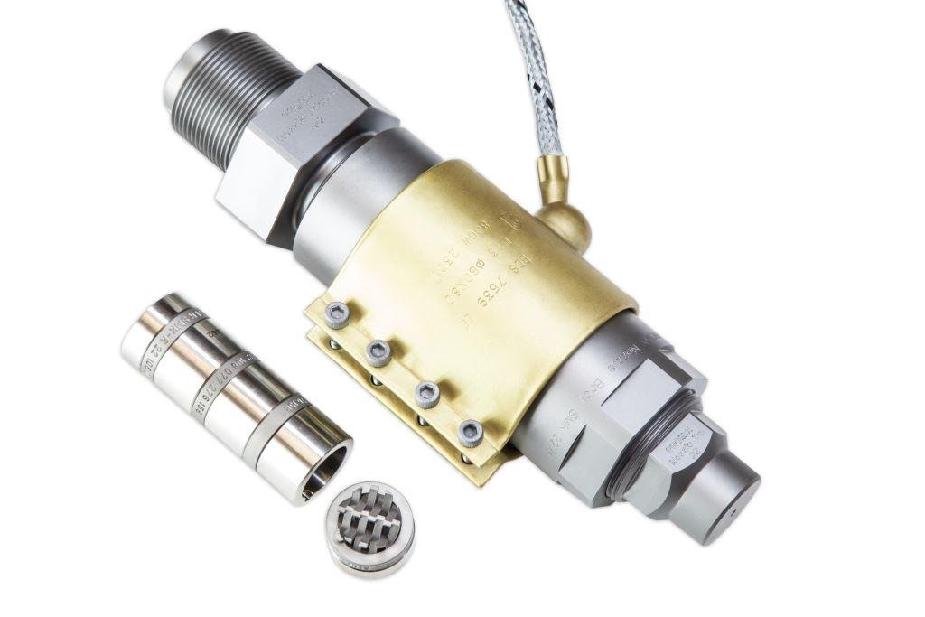
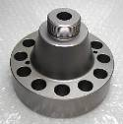
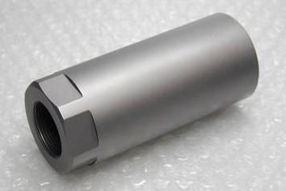
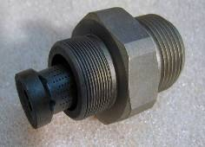

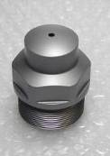
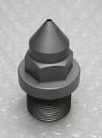
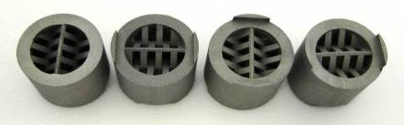


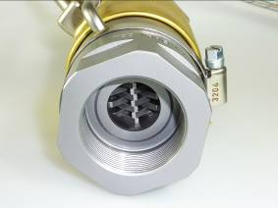
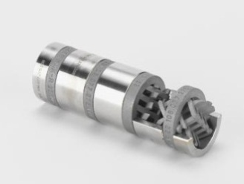

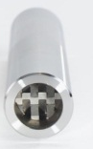
Mixing nozzle concept
Nozzle adapter
Optional:
Protector
Nozzle body
Mixer Type KSM
MixerType SMK
Nozzle Tip
Mix Body Type

Slide 14
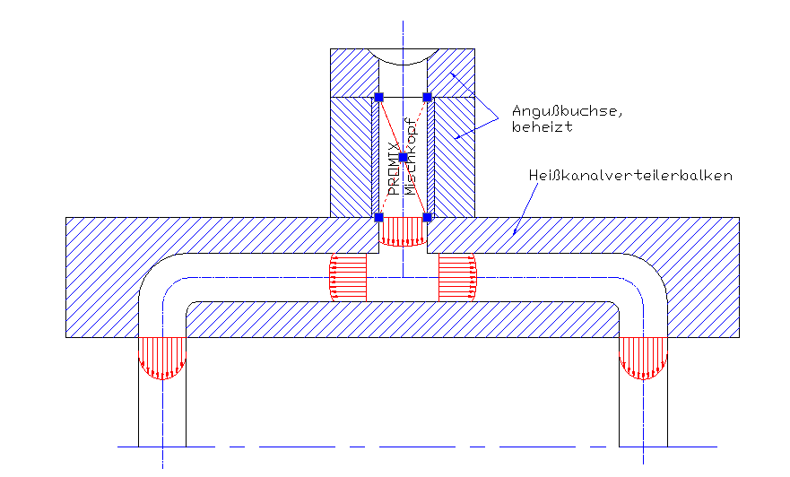
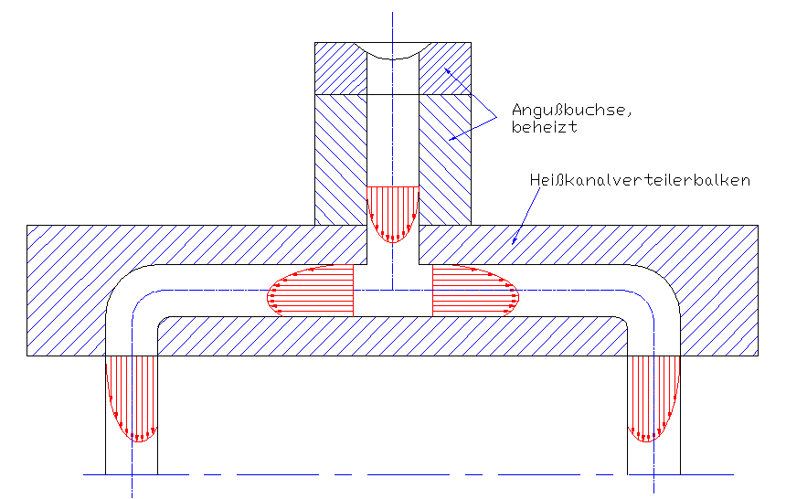
Static Mixers used for hot runner systems
  Filling problems → some cavities can not be filled, whereas others are already overfed
heated gate
heated gate
Hot runner system
Hot runner system
Flow profile WITHOUT Static Mixer
Flow profile WITH Static Mixer
  The balanced flow profile is leading to equally filled cavities and avoids scrap / flash
  Promix Solutions offers customized mixer solutions for hot runner molds
  Process/mold certification is independent from Injection Molding machine

Slide 15
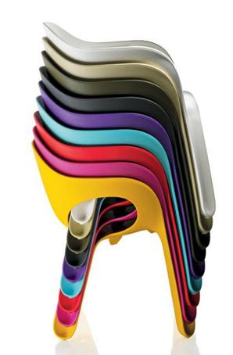
Case studies:
Payback due to reduced color cost
Case Study 1
Application: Garden chair
Machine size: 10500 kN
Screw diameter: 95 mm
Material: PP
Mixer: SMK-R 30/4
Shot weight: 3000 g
Cycle time: 68 sec.
Weekly machine utilization: 120 h
Masterbatch level without mixer: 2 %
Masterbatch level with mixer: 1.6 %
Masterbatch savings per cycle: 20 %
Weekly cost savings in Euro: 173
Pay back time: 3 months
Savings Euro 9000 p.a. due to reduced color cost

Slide 16
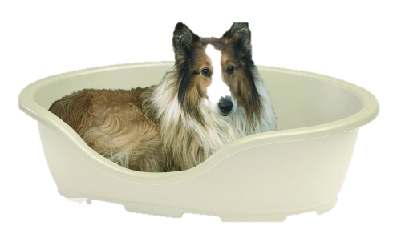
Case studies:
Pay back due to shorter cycle time
Case Study 4
Application: Dog bed
Machine size: 5000 kN
Screw diameter: 80 mm
Material: PP
Mixer: SMK-R 17/4
Shot weight: 1100 g
Cycle time without mixer: 39 sec.
Cycle time with mixer: 36.5 sec.
Cycle time reduction: 6 %
Weekly machine utilization: 120 h
Masterbatch level without mixer: 1.5 %
Masterbatch level with mixer: 1.5 %
Weekly cost savings in Euro: 318
Pay back time: 1 month
Savings Euro 16’500 p.a. due to shorter cycle time

Slide 17
Common concerns
  The required additional pressure drop of a static mixer is too high ➔ the typical injection pressure increase with a Promix static mixer is only 50 - 150 bar specific (+10 to 15 %)
  A static mixer is difficult to clean ➔a Promix static mixer can be best cleaned inline with only 3 to 5 times the volume of the mixer
  I have latest technology injection molding machines and need therefore no static mixers ➔ also new machines have a potential for process optimizations as better color distribution, cycle time reductions, reduction of master batch consumption etc.
  Static mixers can break and damage my moulds ➔ Promix static mixers are produced under highest quality standards and continuous quality control, breaking is almost not possible as long as the mixers will be used according to our operating instructions
Notes:
Show sequence 5) High low viscous mixing from MRT DVD

Slide 18
Contact
General information about Promix Solutions and the product portfolio:
http://www.promix-solutions.com
Videos about the mixing principle and other applications at YouTube:
http://www.youtube.com/PromixSolutions
PROMIX Solutions AG
Technoparkstrasse 2
CH-8406 Winterthur, Switzerland
Tel + +41 52 267 8080, Fax +41 52 267 8081
info@promix-solutions.com
PROMIX Solutions GmbH
Rudolf-Diesel-Strasse 14
DE-35440 Linden, Germany
Tel. +49 6403 779 772 0
Fax + 49 6403 779 772 99

